Slide 1

Data-Driven Electricity Trading Models and Integrated Solution Using Machine Learning Approaches

Slide 2
TABLE OF CONTENTS
1. Data Pre-Processing
2. Training and Test Data Preparation
3. Data Analytics Results
4. Machine Learning Results

Slide 3
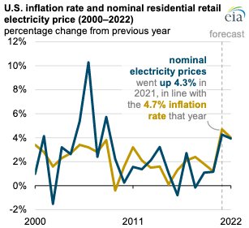
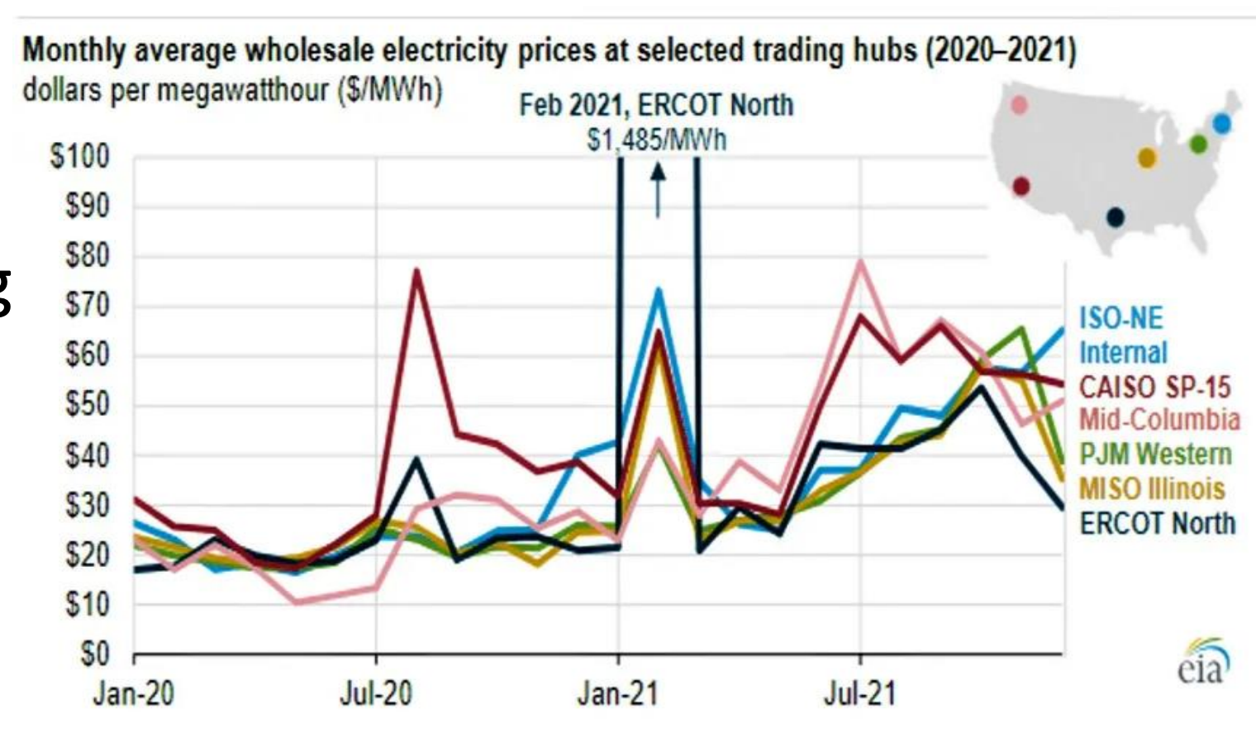
Background
Electricity price has been increasing consistently over the last few years
Electricity price has become increasing volatile in recent years due to climate changes
With the recent advancement of battery technology, there are great opportunities in trading electricity through charging and discharging a collection of batteries (Tesla PowerWall, Megapack).

Slide 4
Data Pre-Processing

Slide 5
Datasets
Smart Electricity Price Prediction project consists of
four types of datasets:
Market Price
System Demand
Node Location
Weather dataset

Slide 6
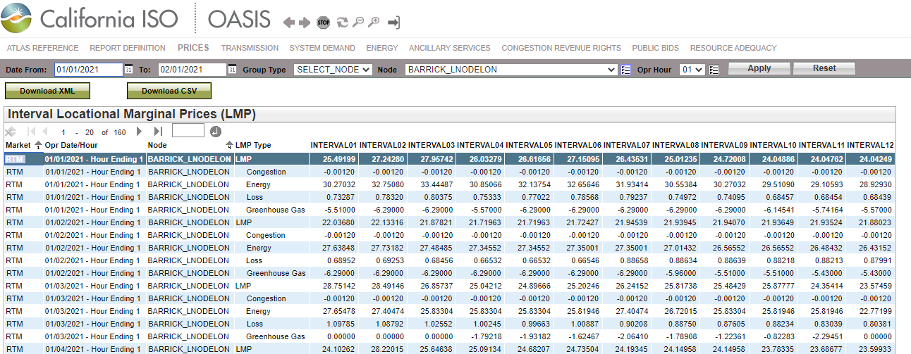
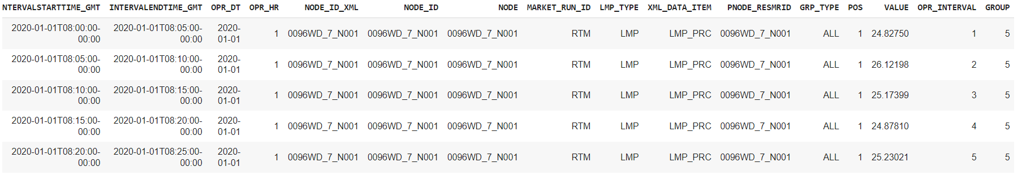
Market Price from CAISO

Slide 7
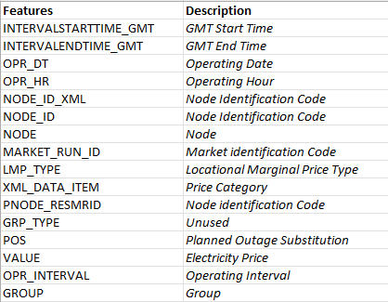
Market Price dataset features

Slide 8
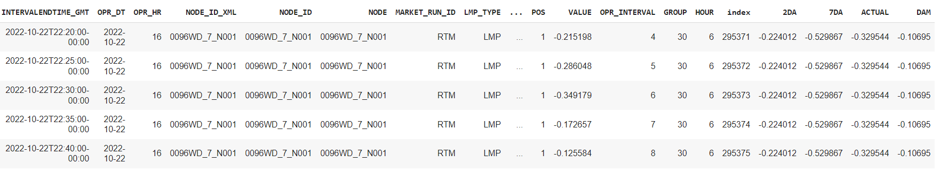
Demand Forecast from CAISO

Slide 9
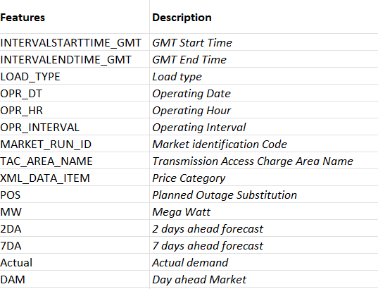
Demand Forecast dataset features

Slide 10
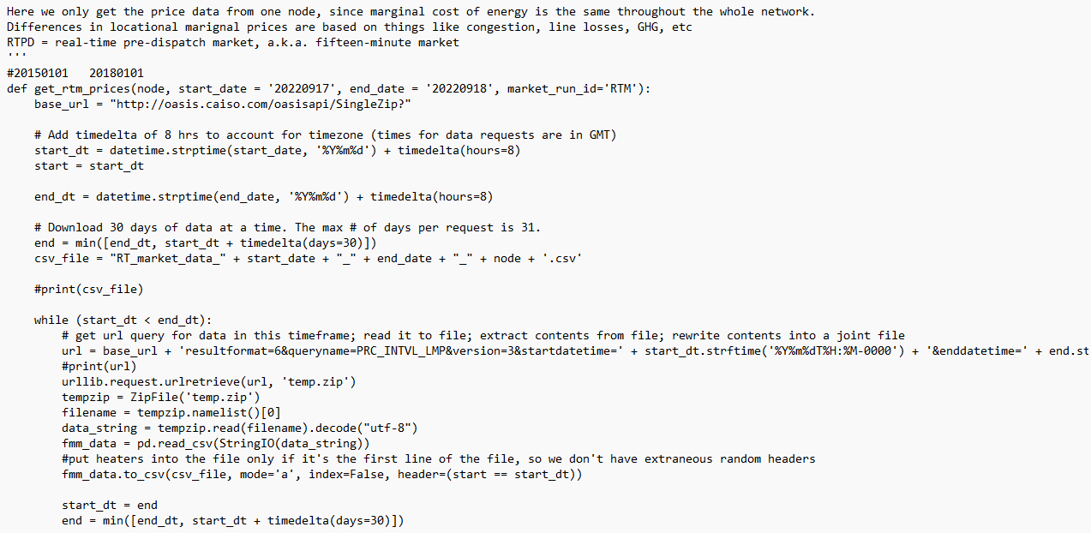
Data Collection
Python script to collect data
Acknowledgement
Dr. Wang

Slide 11
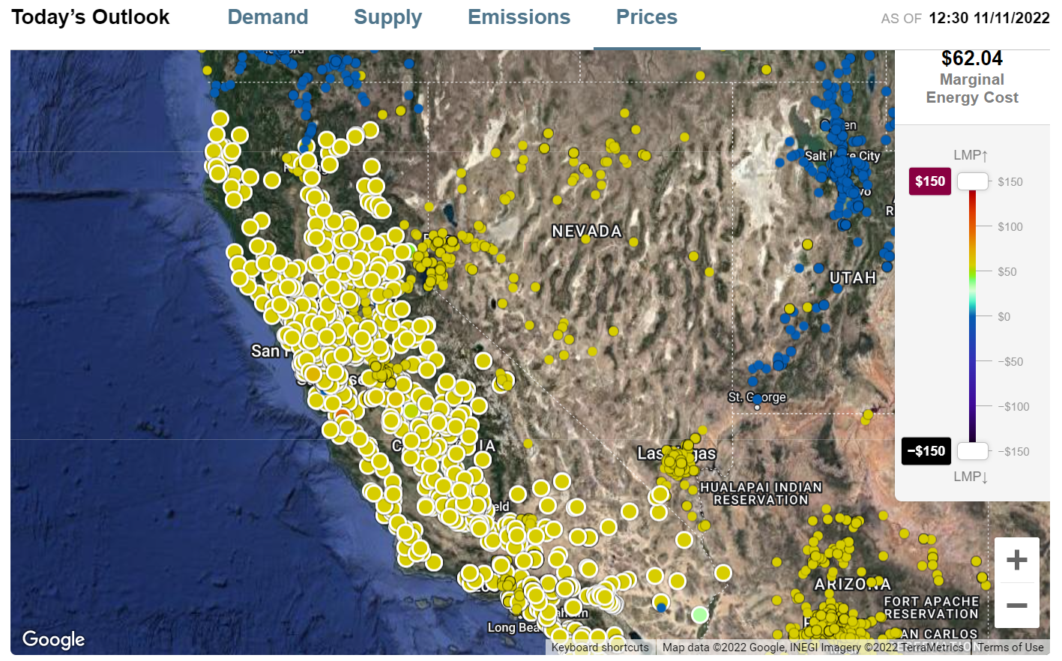
Node Location

Slide 12
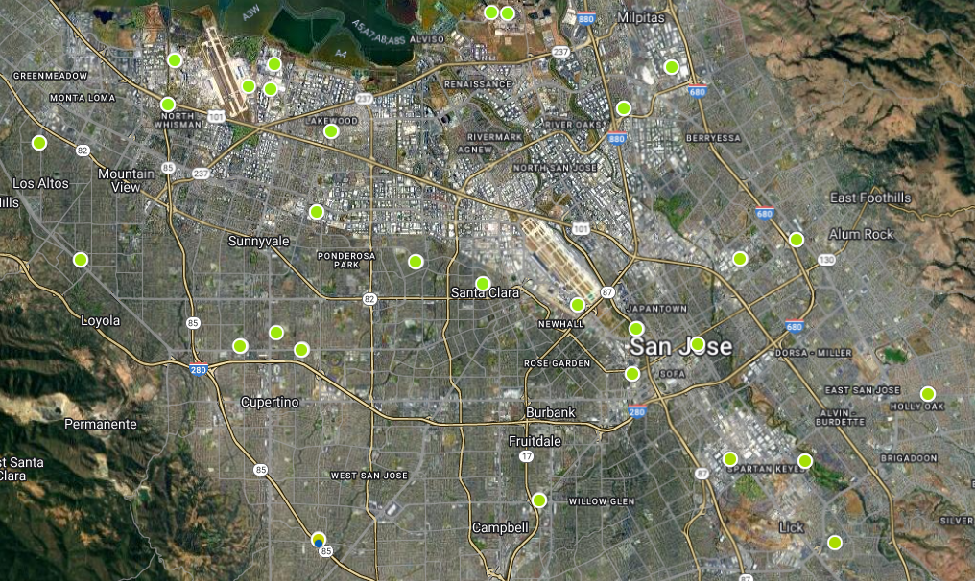
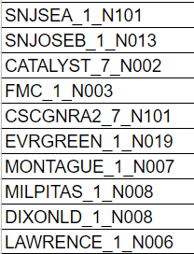
10 PNodes in the Bay Area

Slide 13
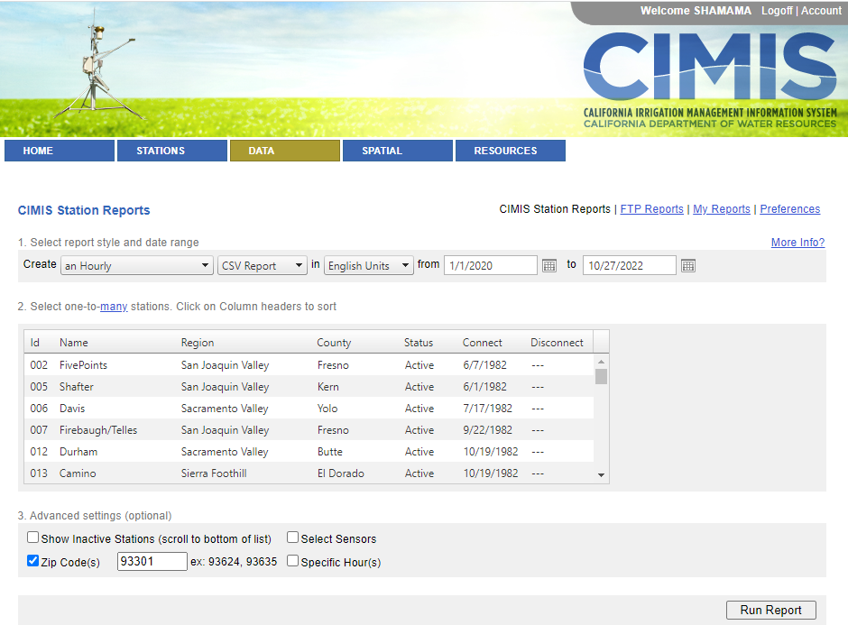
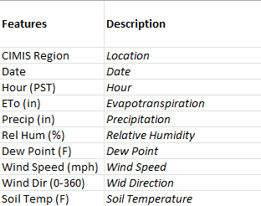
Weather Dataset

Slide 14
Data Preprocessing
Filtered to include only real-time market data = LMP in the Market Price dataset
Filtered by TAC Area: Transmission access charge (TAC) area in Demand dataset
Interval Start Time and End Time in GMT. This time needs to be converted to California local time
Handling Variability: Price normalization
Joining 3 Datasets on time

Slide 15
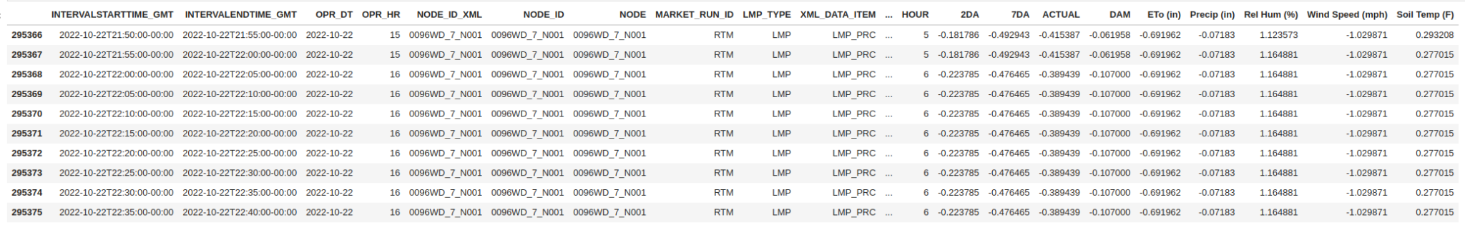
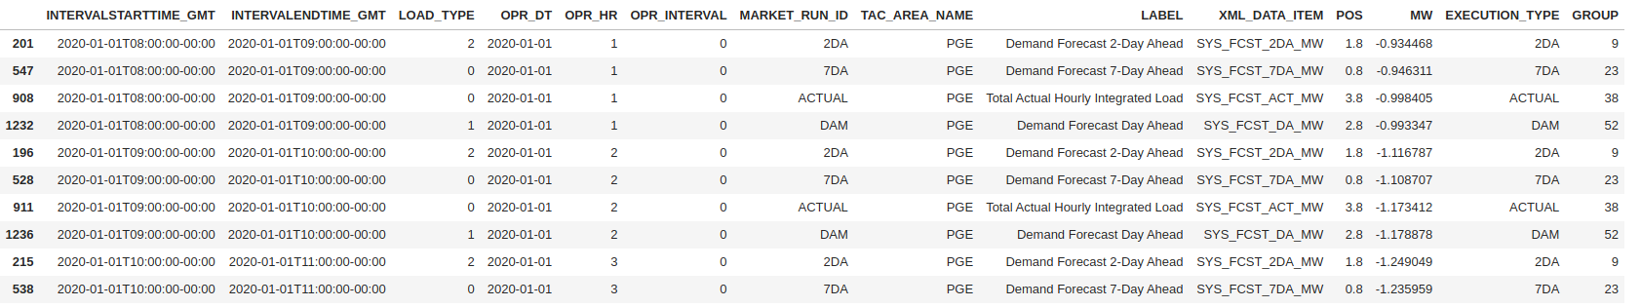
Samples
Real time market data
Demand forecast data
Weather data

Slide 16
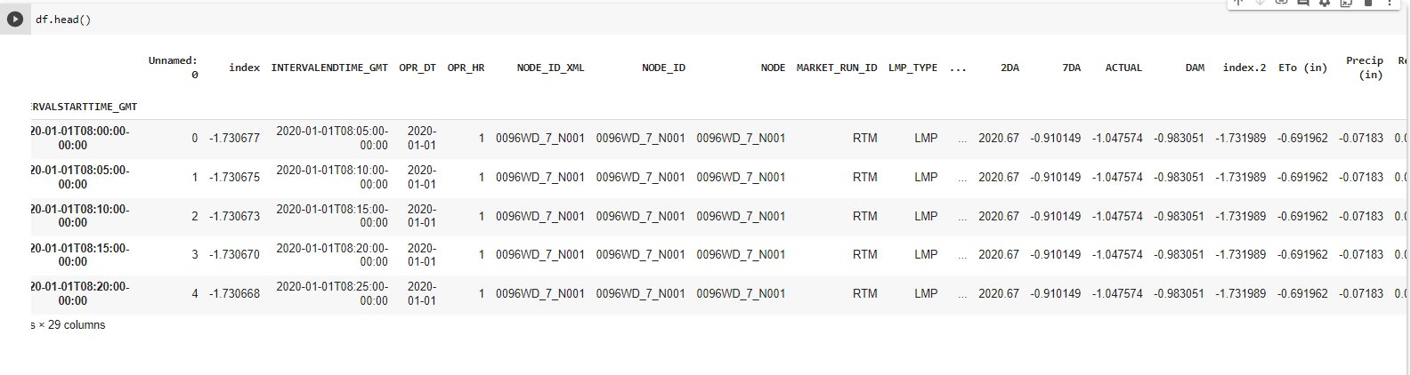
Final Joined Sample
Sample of the final dataset

Slide 17
Feature Engineering
Input features: 'INTERVALSTARTTIME_GMT', ‘INTERVALENDTIME_GMT', 'OPR_DT', 'OPR_HR', 'NODE_ID_XML', 'NODE_ID', 'NODE', 'MARKET_RUN_ID', 'LMP_TYPE', 'XML_DATA_ITEM', 'PNODE_RESMRID', 'GRP_TYPE', 'OPR_INTERVAL', 'GROUP', 'HOUR', '2DA', '7DA', 'ACTUAL', 'DAM'', 'ETo (in)', 'Precip (in)', 'Rel Hum (%)', 'Wind Speed (mph)', 'Soil Temp (F)'.
Output feature: ‘VALUE’ which represents the electricity price
Categorical features: "INTERVALENDTIME_GMT", "OPR_DT", "OPR_HR", "NODE_ID_XML", "NODE_ID", "NODE", MARKET_RUN_ID", "LMP_TYPE", "XML_DATA_ITEM","PNODE_RESMRID", "GRP_TYPE"
Set Index: 'INTERVALSTARTTIME_GMT'
Final 13 features: 'POS', 'OPR_INTERVAL', 'GROUP', 'HOUR', '2DA', '7DA', 'ACTUAL', 'DAM', 'ETo (in)', 'Precip (in)', 'Rel Hum (%)', 'Wind Speed (mph)',
'Soil Temp (F)'

Slide 18
Training and Test Data Preparation

Slide 19
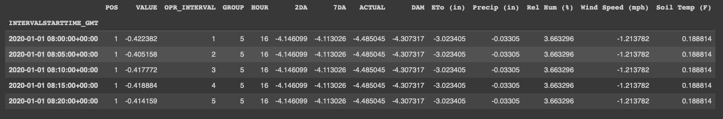
Features in Train/Test Dataset
Weather | Demand | Market Data
'ETo (in)' 'Precip (in)’ 'Rel Hum (%)' 'Wind Speed (mph)' ‘'Soil Temp (F)' | '2DA' '7DA' 'ACTUAL' 'DAM' | 'POS' 'OPR_INTERVAL’ 'GROUP' HOUR **Value is used for evaluation metrics**

Slide 20
Train and Test Data Comparison
 | Raw | Processed | Train | Test
Time Interval | 2020-2022 | 2020-2022 | 2020-2021 | 2022
# of observations | 3,125,952 | 3,125,952 | 3,047,328 | 78,624
# of attributes | 28 | 13 | 13 | 13

Slide 21
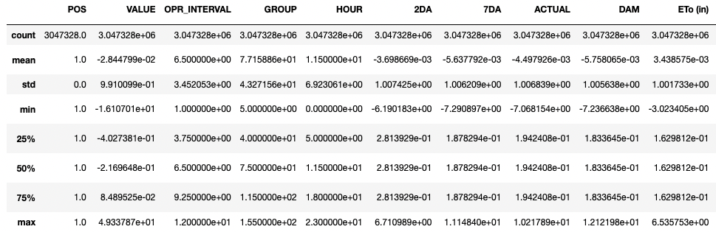
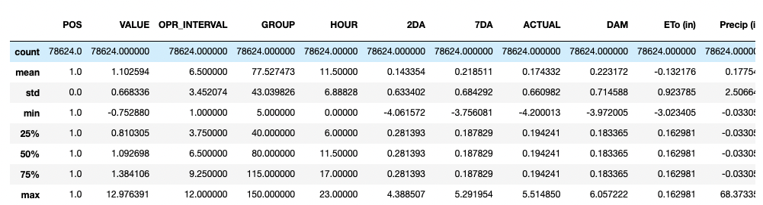
Train and Test Data Comparison
Train data
Test data

Slide 22
Data Analytics Results

Slide 23
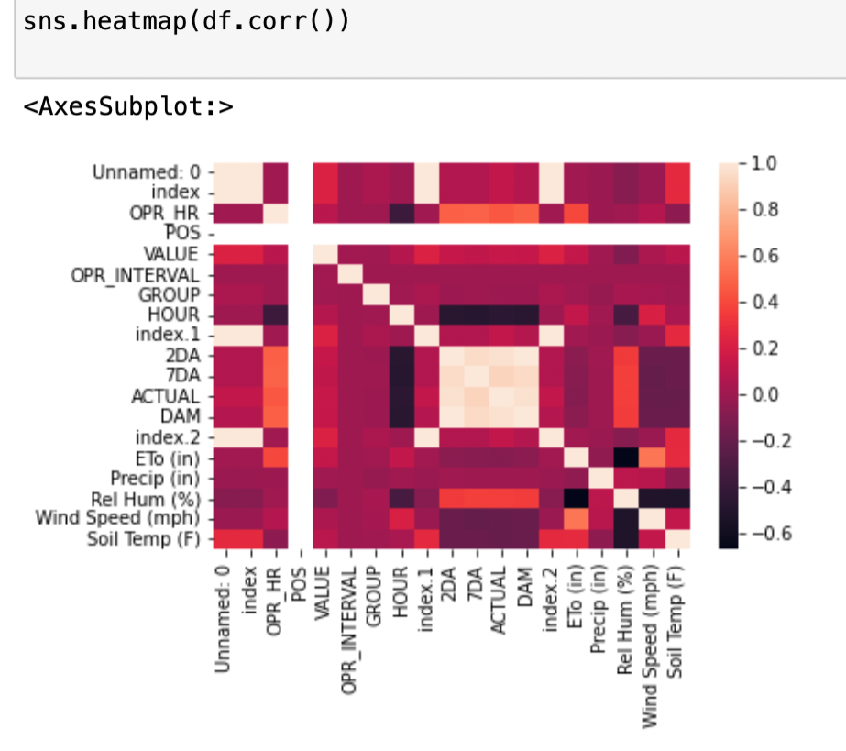
Data Statistics
VALUE is our variable of interest
Correlation heat map shows high correlation between the demand variables (2DA, 7DA, ACTUAL, DAM), operating hour, and relative humidity

Slide 24
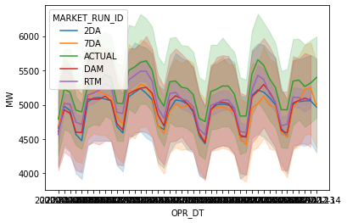
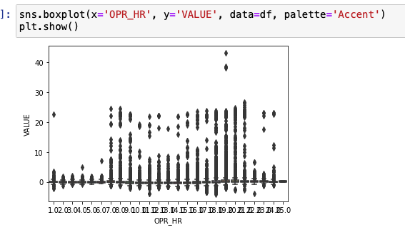
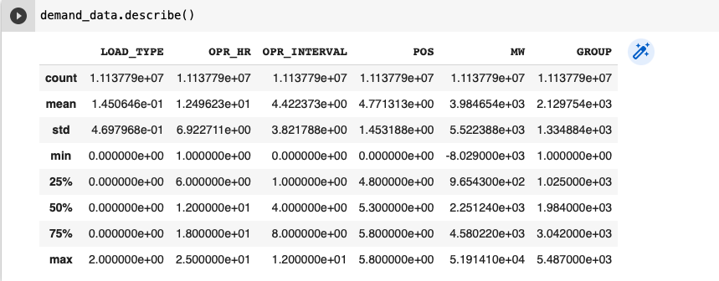
Data Statistics
normalized data has values between 0-1.

Slide 25
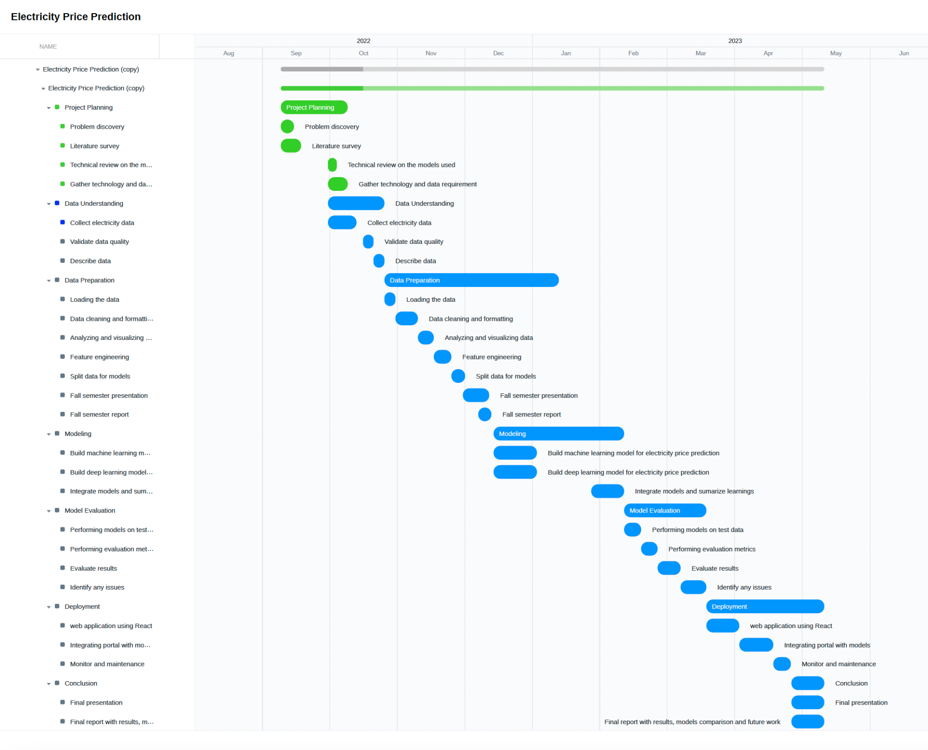
Gantt Chart

Slide 26
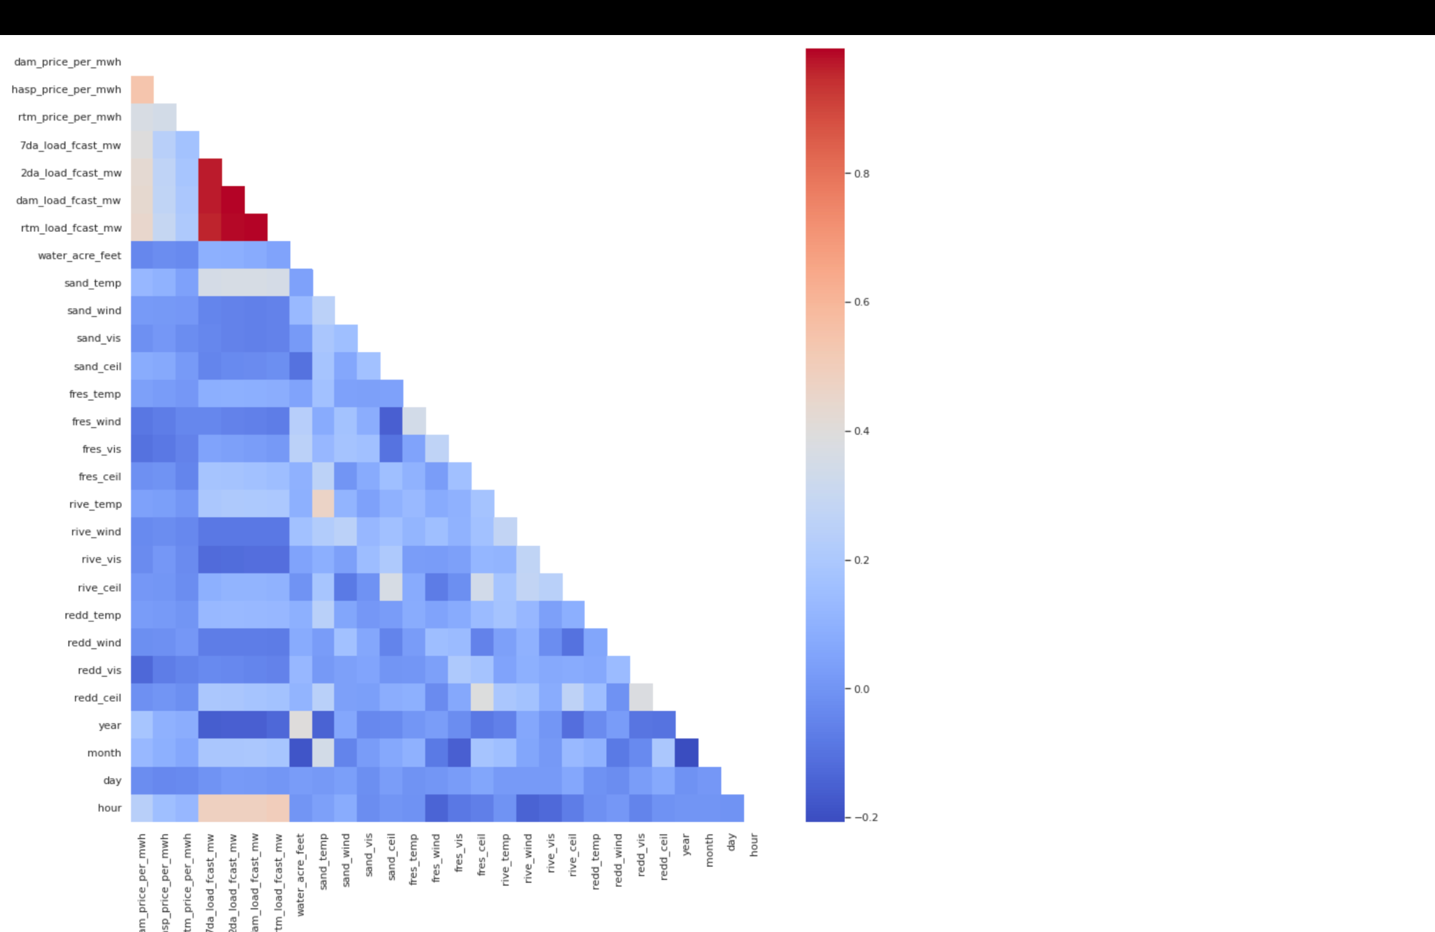
More than 30,000 hours of data captured
Overall correlations are weak

Slide 27
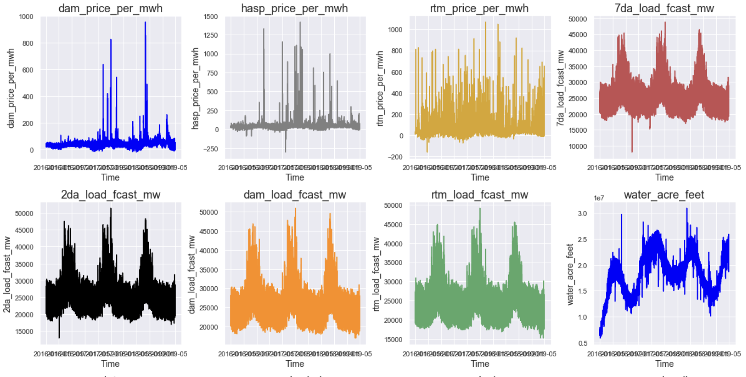
Data Visualization of Training data using gen_linecharts
Two target columns(DAM and HASP)

Slide 28
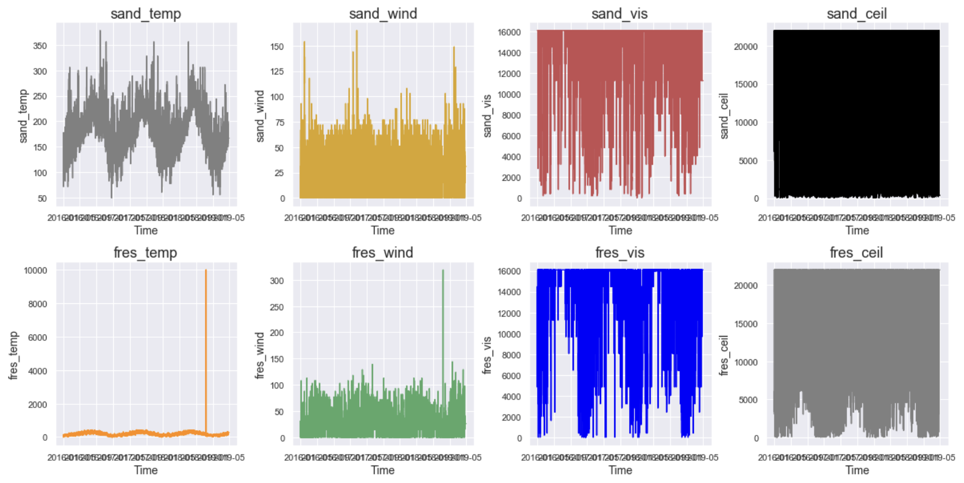
Other features such as water , sand, wind etc

Slide 29
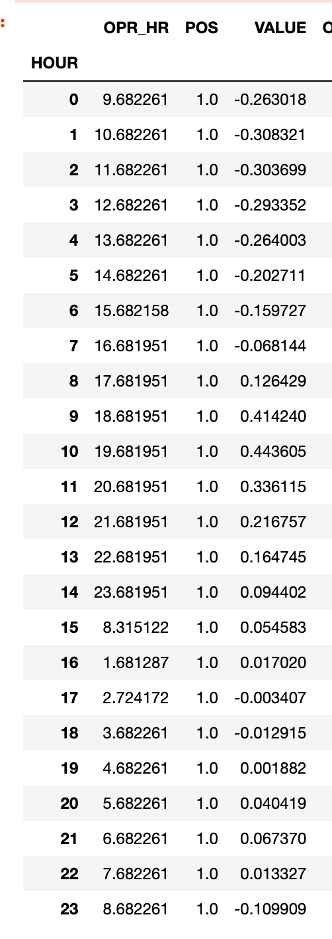
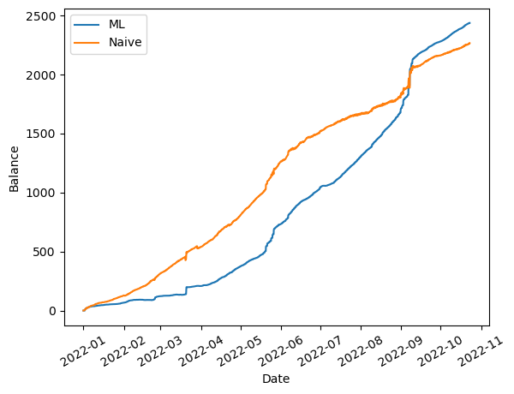
Simulation of a Tesla PowerWall
Capacity: 13.5 kWh
Charging/Discharge speed: 3.3 kW
Assume we can sell at PGE’s rate

Slide 30
Machine Learning Results

Slide 31
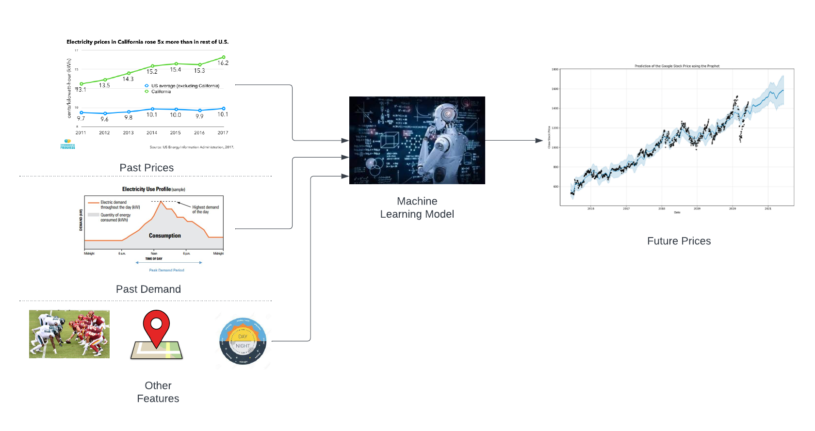
Goal of the Model
Notes:
More specifically, …

Slide 32
Model Inputs and Outputs
Input
Past Data (hourly in the past 7 days)
Market price
Weather (temperature, moisture, etc)
Location, Event, Date, Time
Forecast Data (hourly in the next 7 days)
Demand and supply forecast
Output
Predicted price in the next day (hourly interval)
Notes:
More specifically, …

Slide 33
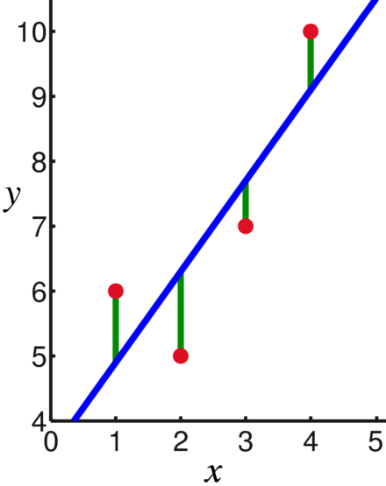
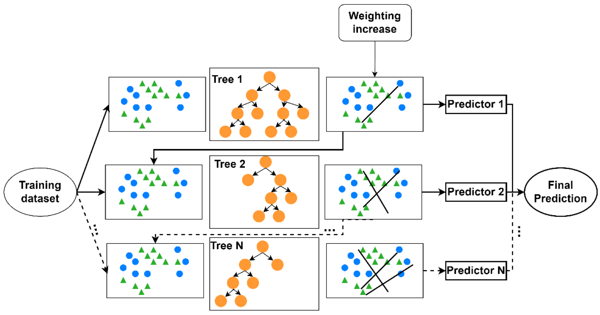
Classic Machine Learning Models
We selected some classic machine learning algorithms as baselines
Linear Regression
XGBoost

Slide 34
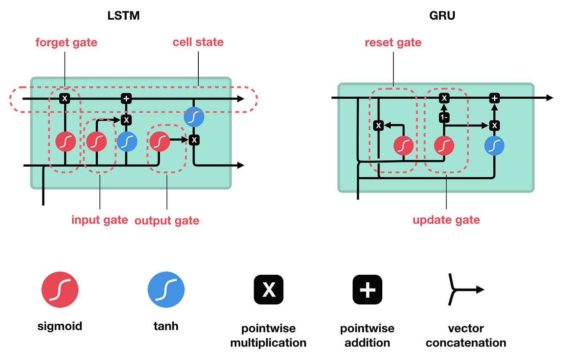
Deep Learning Models
Recurrent Neural Networks
Long-Short Term Memory
Gated Recurrent Unit

Slide 35
Innovative Machine Learning Models
Feature Interaction
We leveraged embedding to model events and temporal features
Motivated by DCN, we add feature interaction modules
Multi-Task Learning
We improved the model via adding multiple objectives instead of one price prediction
Transformer
Leveraged Transformer Encoders

Slide 36
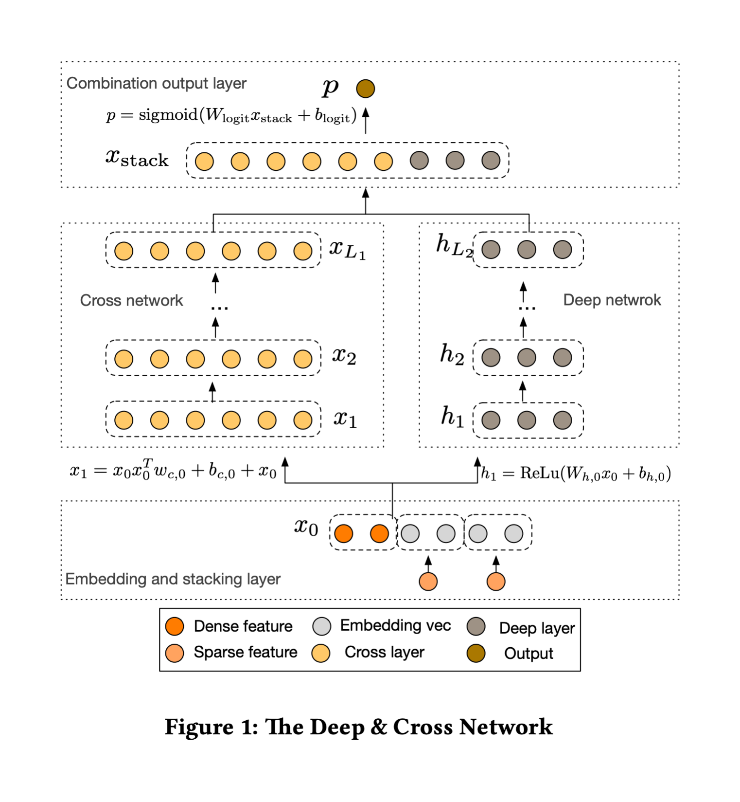
Feature Interaction
Feature Interactions
Between Prices and
Weather/Events
No manual feature
engineering

Slide 37
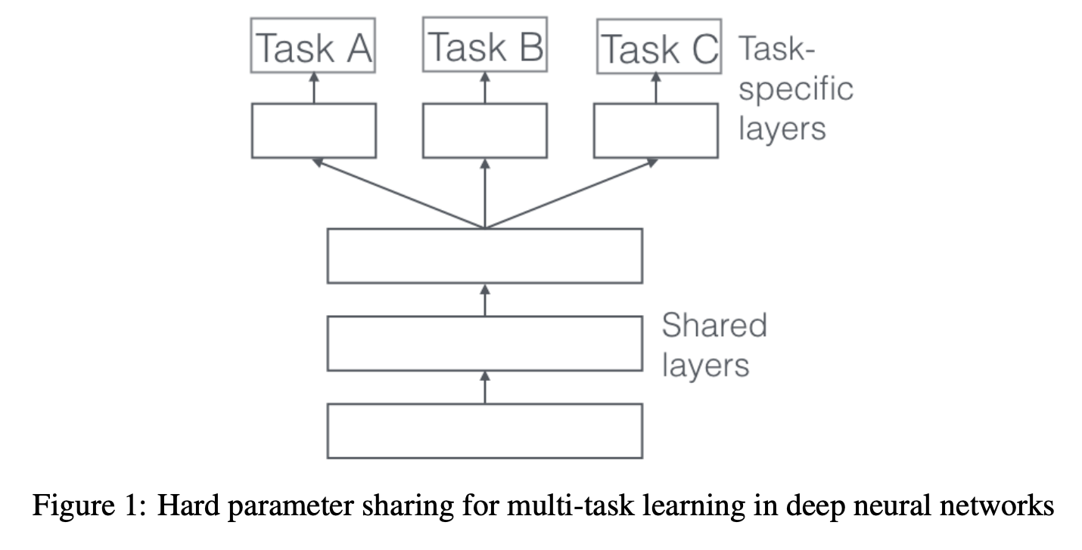
Multi-Task Learning
Market Price Prediction
High and low prediction
…
MTL improves overall
learning
Notes:
In literature reviews, MTL usually improves the

Slide 38
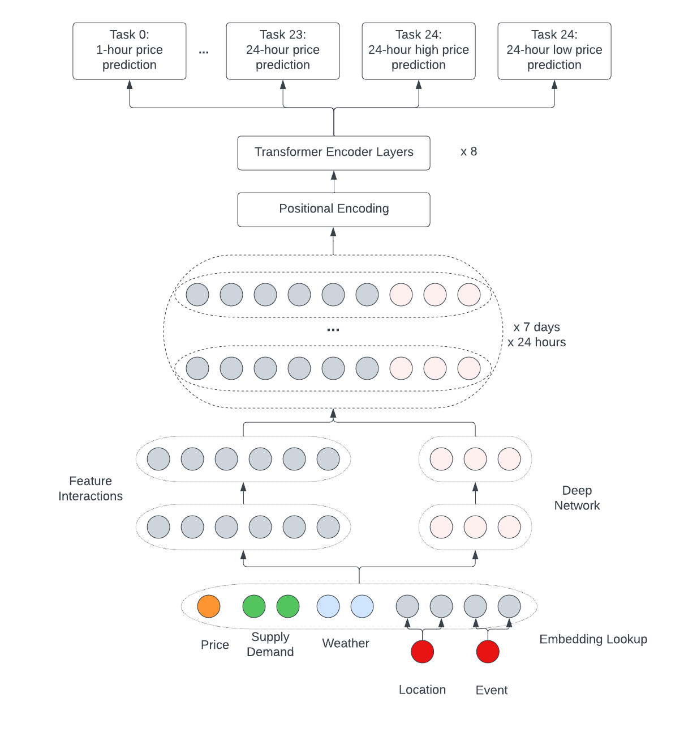
Notes:
In literature reviews, MTL usually improves the

Slide 39
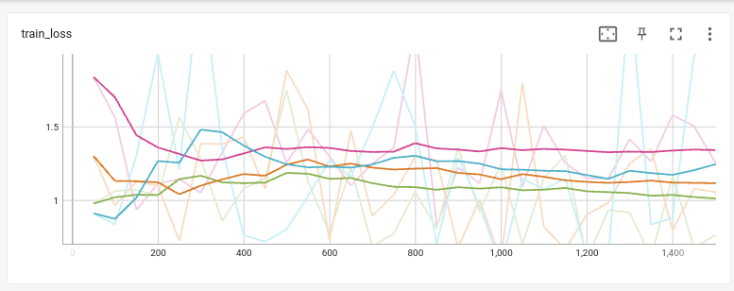
Training Losses

Slide 40
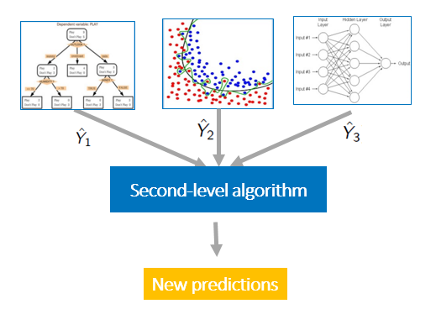
Ensemble Models
Averaging everything together
It doesn’t work!
Average is still worse than
the best model.
Learned weights based on inputs
Learned weights to combine
model outputs
StackingRegressor with
RidgeRegression

Slide 41
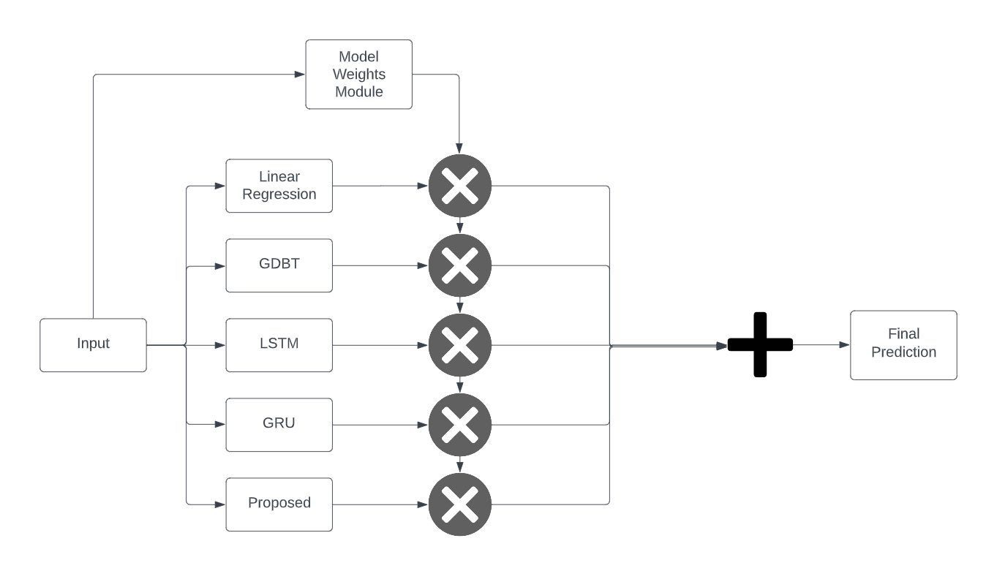
Ensemble Models

Slide 42
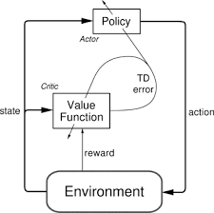
Reinforcement Learning
OpenAI Gym + Stable Baseline 3
Action Space
Price ranges
Observation Space
Features
Reward
MSE loss
Proximal Policy Optimization (PPO)
MlpPolicy (ActorCriticPolicy)

Slide 43

Evaluation Metrics
Seasonality Evaluation
Root Mean Squared Error (RMSE)
Mean Absolute Error (MAE)
Mean Absolute Percentage Error (MAPE)
All days of the week
Weekdays (Mon - Fri)
Summer Months (May - sep)

Slide 44
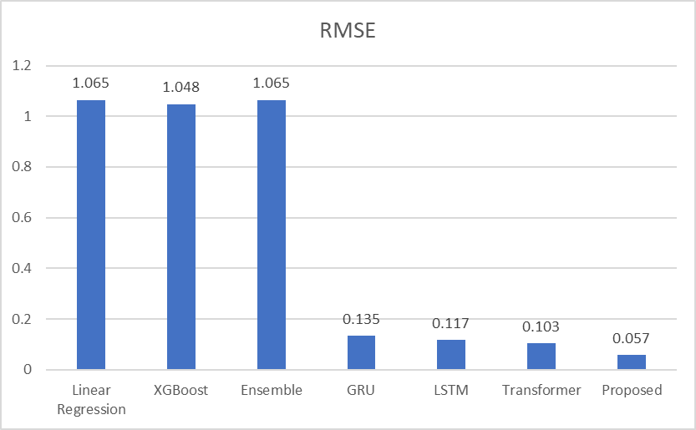

Slide 45
RMSE
Model | All days | Weekdays | Summer Months
Linear Regression | 1.065 | 1.123 | 1.157
XGBoost | 1.048 | 1.104 | 1.113
Reinforcement Learning | 1.133 | 1.211 | 1.330
Ensemble | 1.065 | 1.123 | 0.849
GRU | 0.135 | 0.197 | 0.367
LSTM | 0.117 | 0.410 | 0.281
Transformer | 0.103 | 0.129 | 0.162
Proposed | 0.057 | 0.578 | 0.271

Slide 46
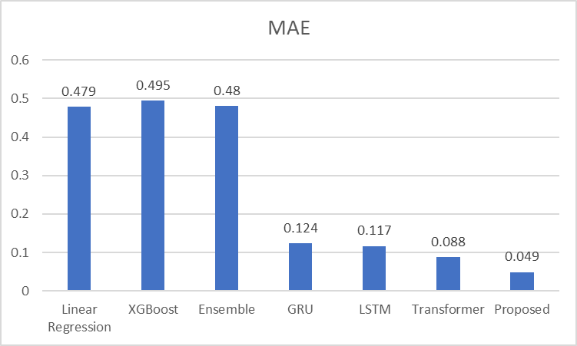

Slide 47
MAE
Model | All days | Weekdays | Summer Months
Linear Regression | 0.479 | 1.123 | 0.436
XGBoost | 0.495 | 1.104 | 0.437
Reinforcement Learning | 0.513 | 0.565 | 0.633
Ensemble | 0.48 | 0.493 | 0.409
GRU | 0.124 | 0.197 | 0.356
LSTM | 0.117 | 0.405 | 0.272
Transformer | 0.088 | 0.109 | 0.124
Proposed | 0.049 | 0.075 | 0.118

Slide 48
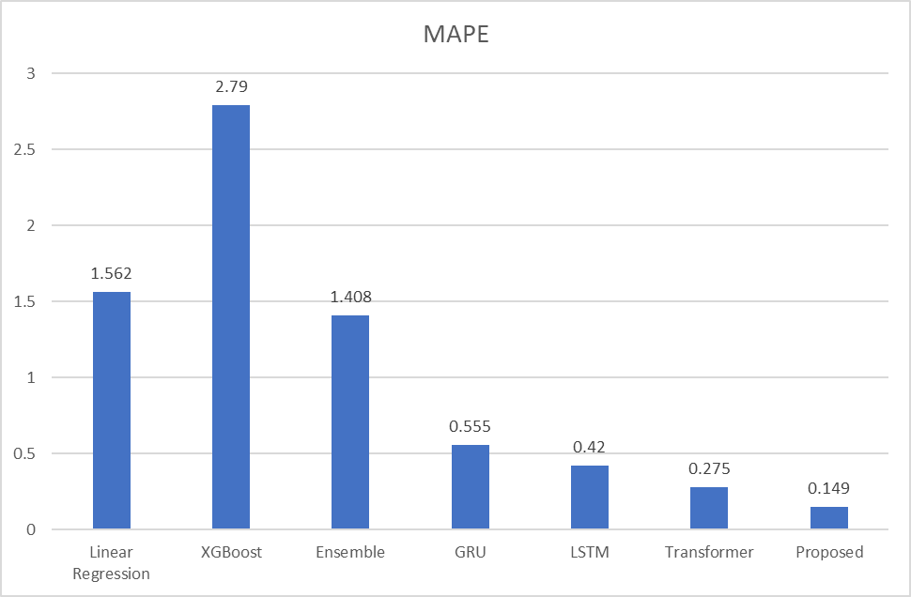

Slide 49
MAPE
Model | All days | Weekdays | Summer Months
Linear Regression | 1.562 | 1.123 | 1.634
XGBoost | 2.790 | 1.104 | 3.082
Reinforcement Learning | 4.213 | 4.386 | 4.707
Ensemble | 1.408 | 1.012 | 1.624
GRU | 0.555 | 0.197 | 2.792
LSTM | 0.420 | 17.051 | 1.211
Transformer | 0.275 | 0.462 | 0.396
Proposed | 0.149 | 0.791 | 2.008

Slide 50
Runtime Comparison
Model | Runtime in second
Linear Regression | 0.058
XGBoost | 10.54
GRU | 1216
LSTM | 219
Transformer | 0.14
Proposed | 1807.21
Proposed Optimized | 301.3
Google Colab VM
GPU Model: Nvidia K80 / T4, GPU Memory: 12GB
GPU Memory Clock: 0.82GHz / 1.59GHz
Performance: 4.1 TFLOPS / 8.1 TFLOPS
No. of CPU Cores: 2, RAM: 12GB

Slide 51
Proposed Model
Training Cost Analysis
Sparse lookups ~ 5%
MLPs ~ 5%
Transformer ~ 90%
Shows how transformer can leverage the power of computes
The optimization is mostly on this part to reduce the size of inputs

Slide 52
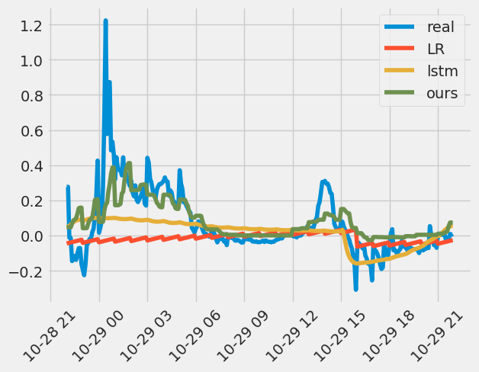
Actual Price vs Predicted Price

Slide 53
System Portal Design

Slide 54
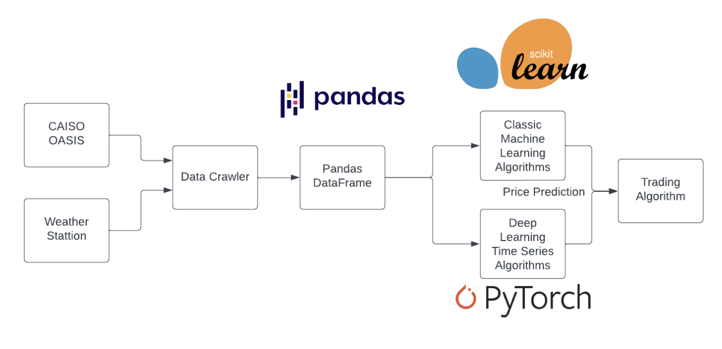
Model System Design

Slide 55
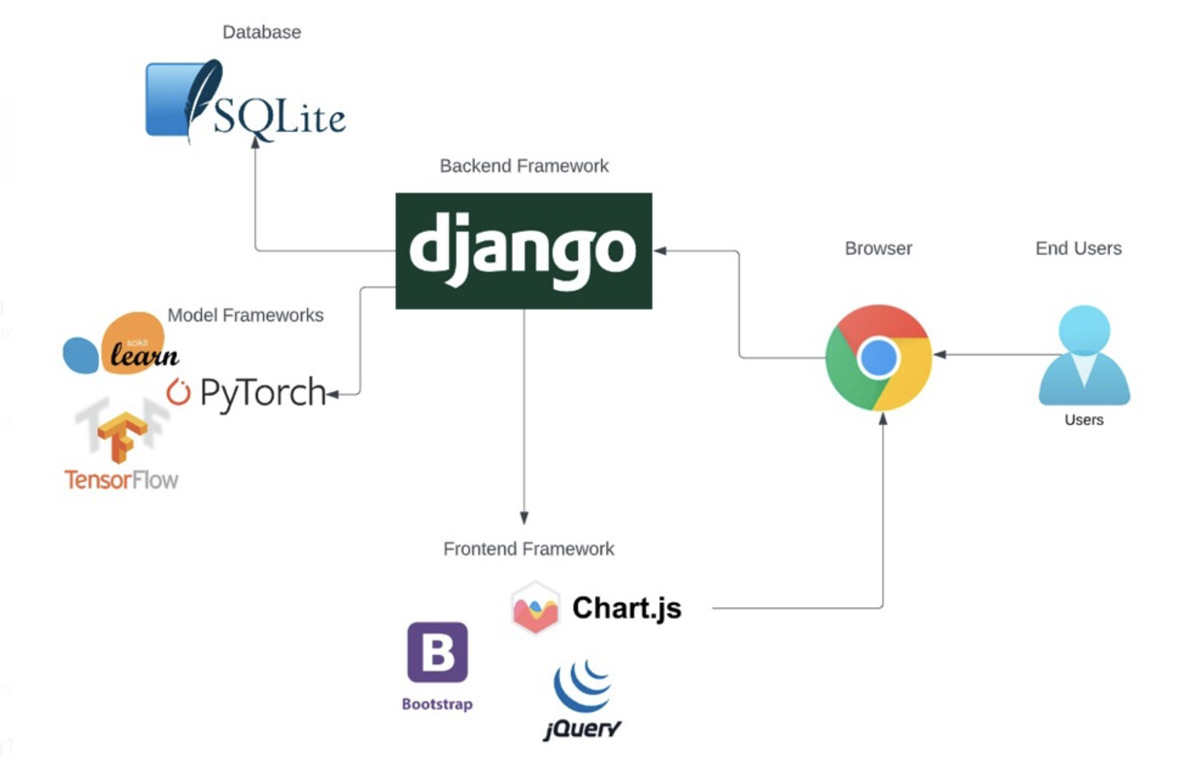
UI System Design

Slide 56
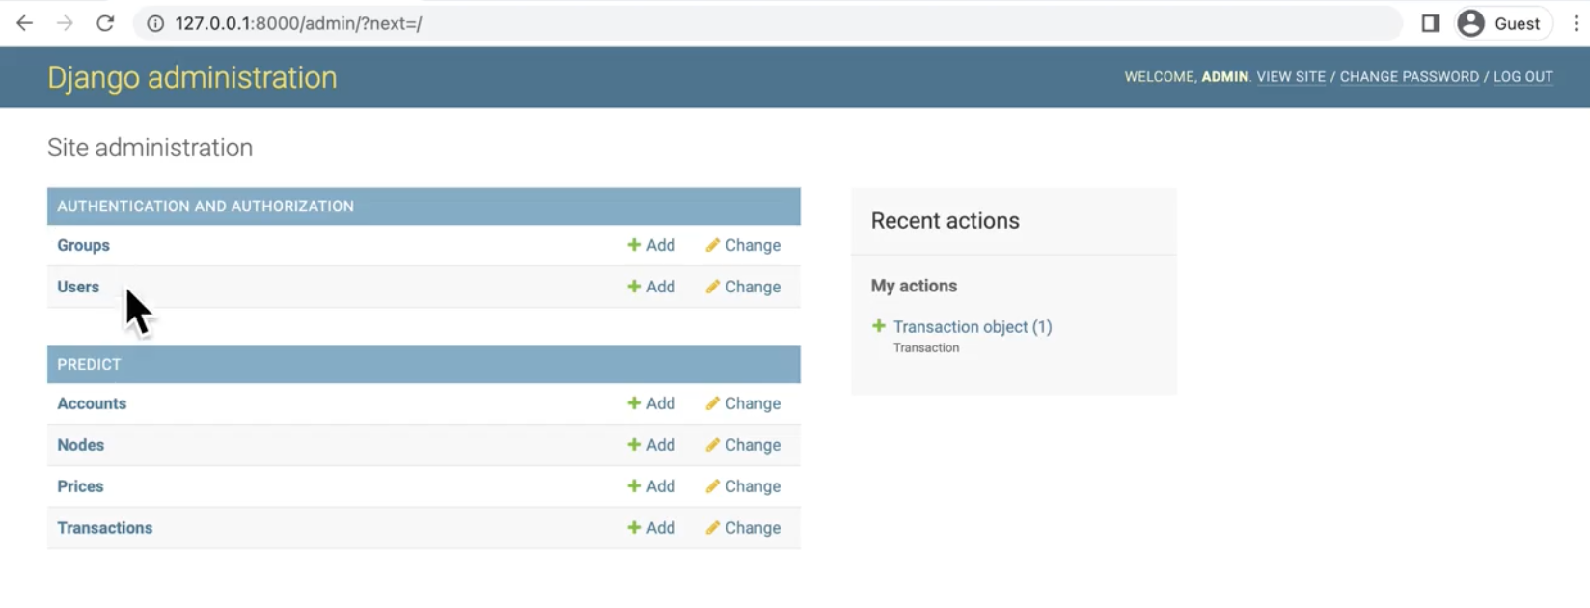
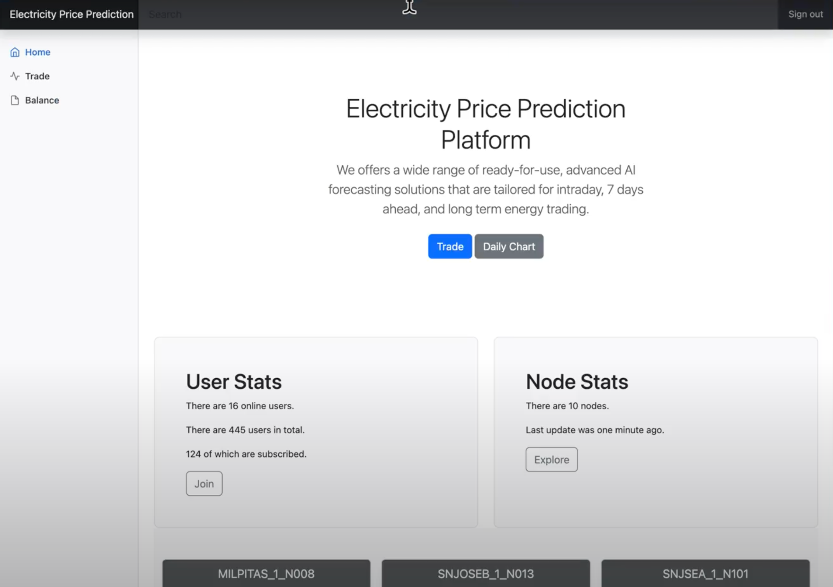
Admin Page
User Home page

Slide 57
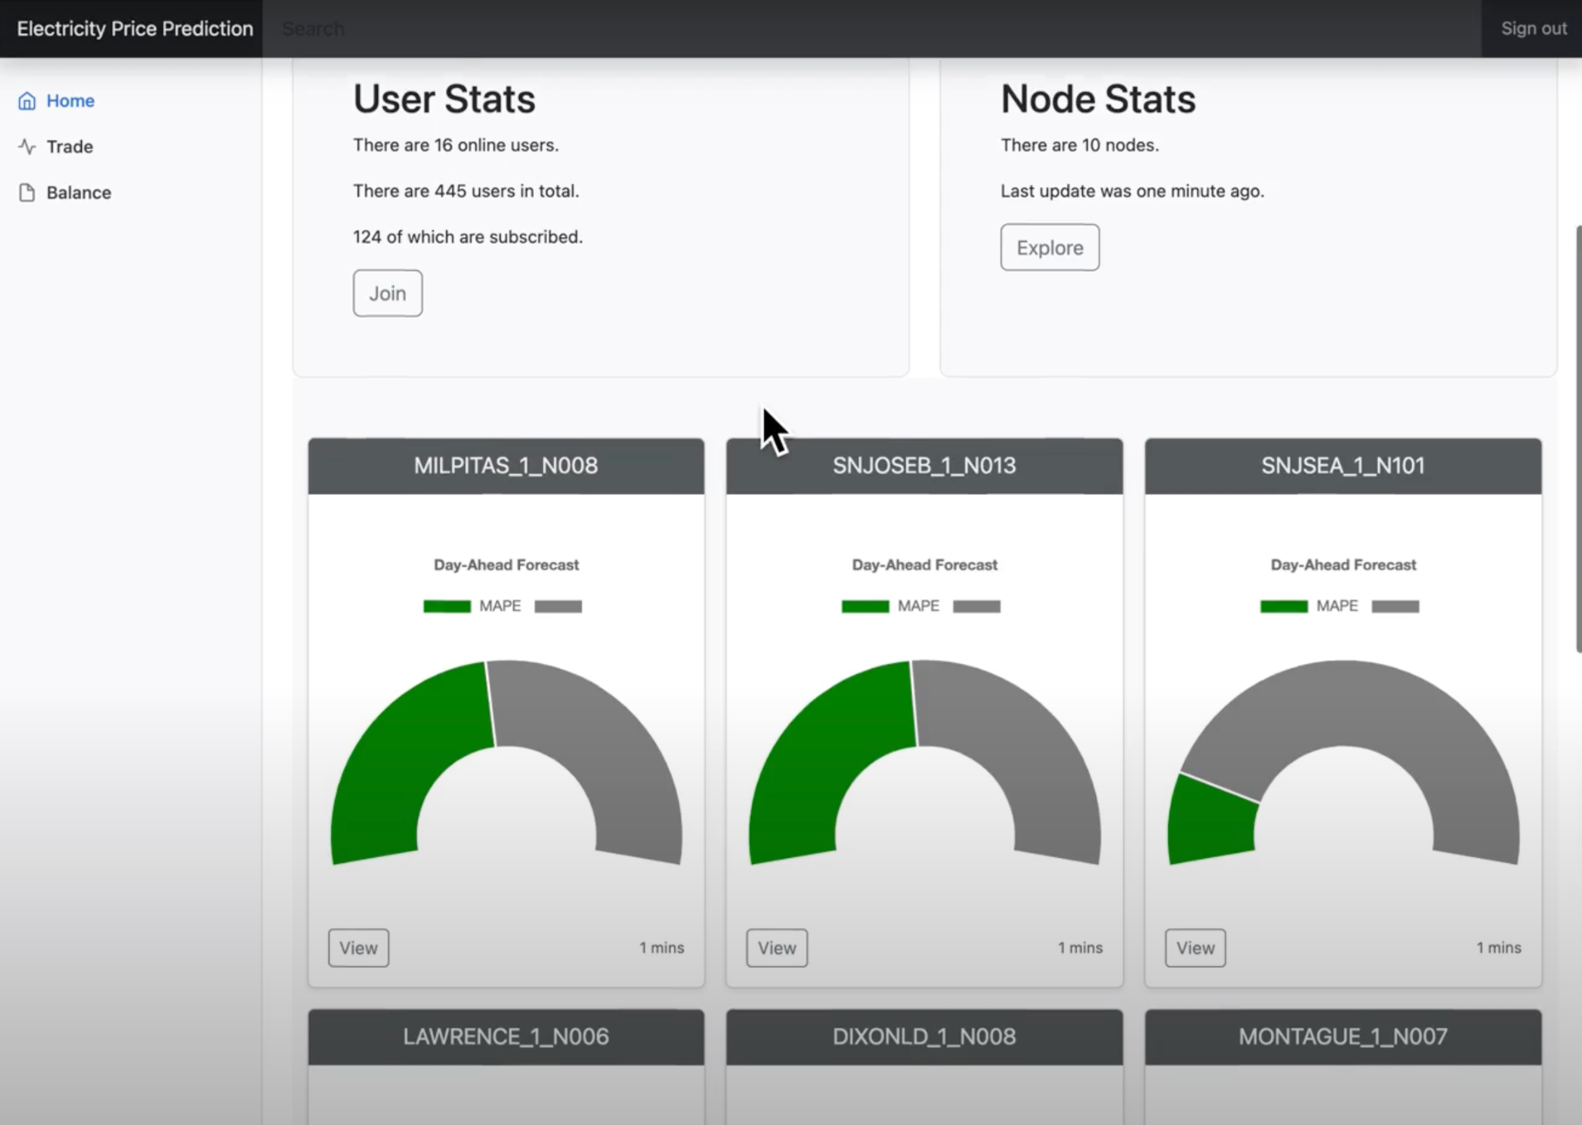
User interface with user and node statistics

Slide 58
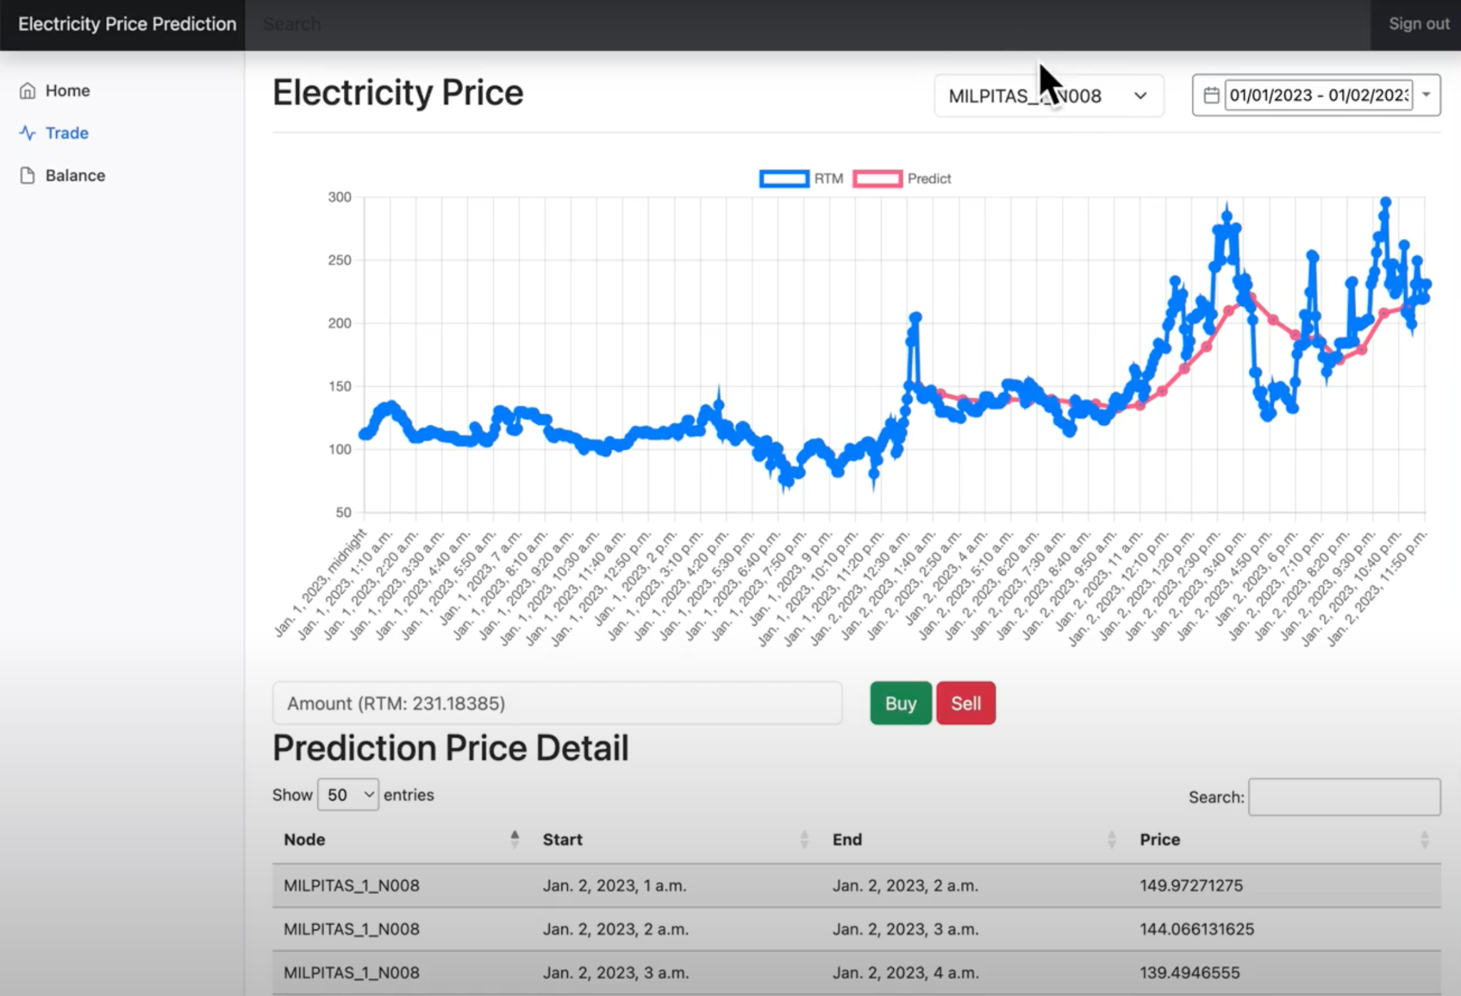

Demand and prediction graph
Prediction price detail on hourly basis

Slide 59

DEMO VIDEO

Slide 60
THANK YOU

